Slide 1
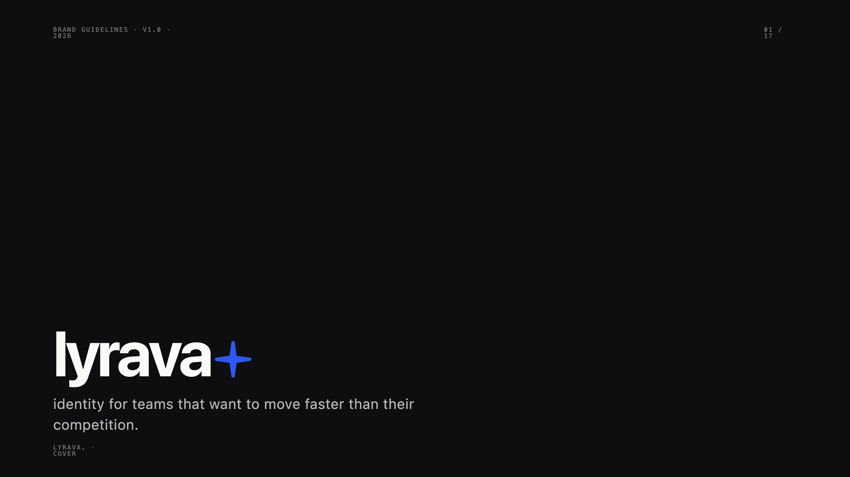
Notes:
Cover. Brand guidelines version one, May 2026. Setting up that lyrava is identity for teams that want to move faster than their competition.

Slide 2
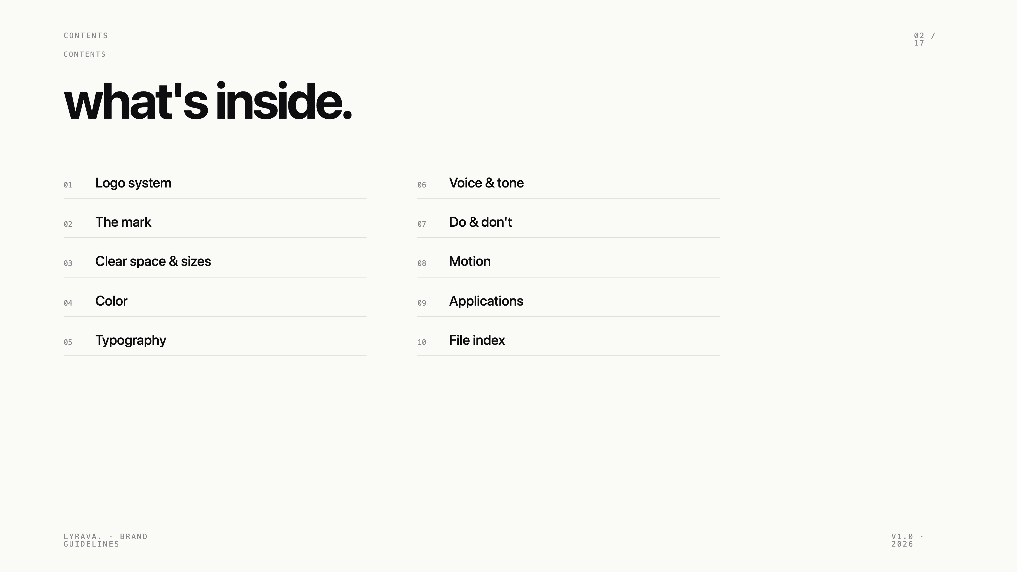
Notes:
Contents. Ten sections — logo, mark, clear space, color, type, voice, do and don't, motion, applications, file index.

Slide 3
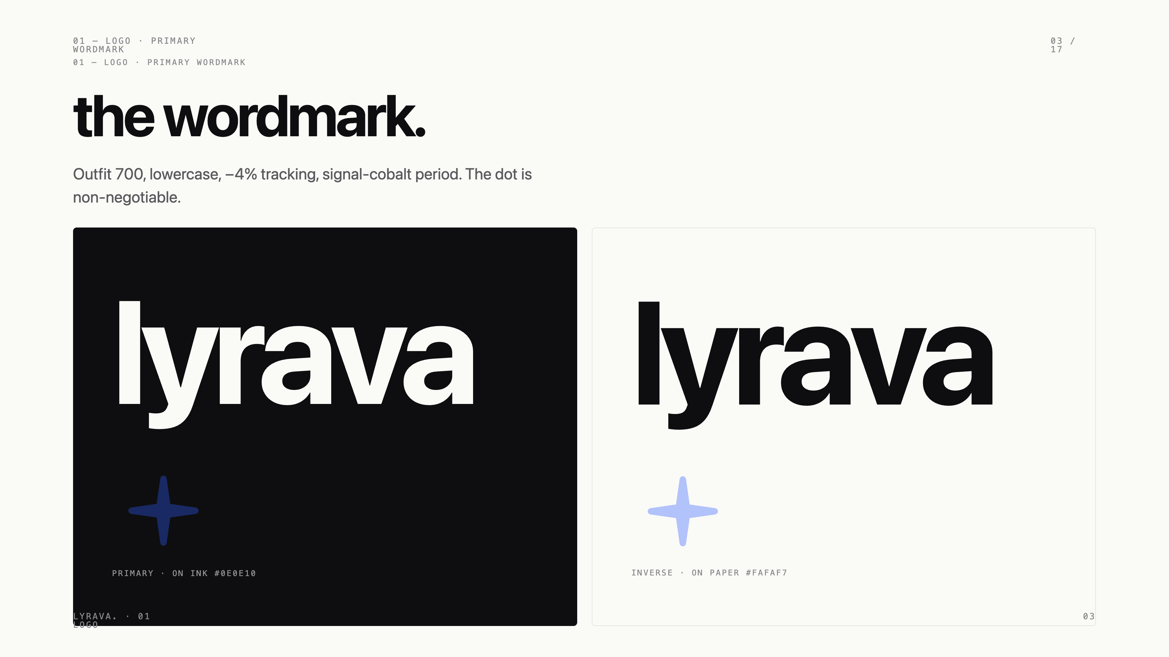
Notes:
Primary wordmark. Outfit 700, lowercase, minus four percent tracking. The signal dot at the end is the brand's most recognisable element.

Slide 4
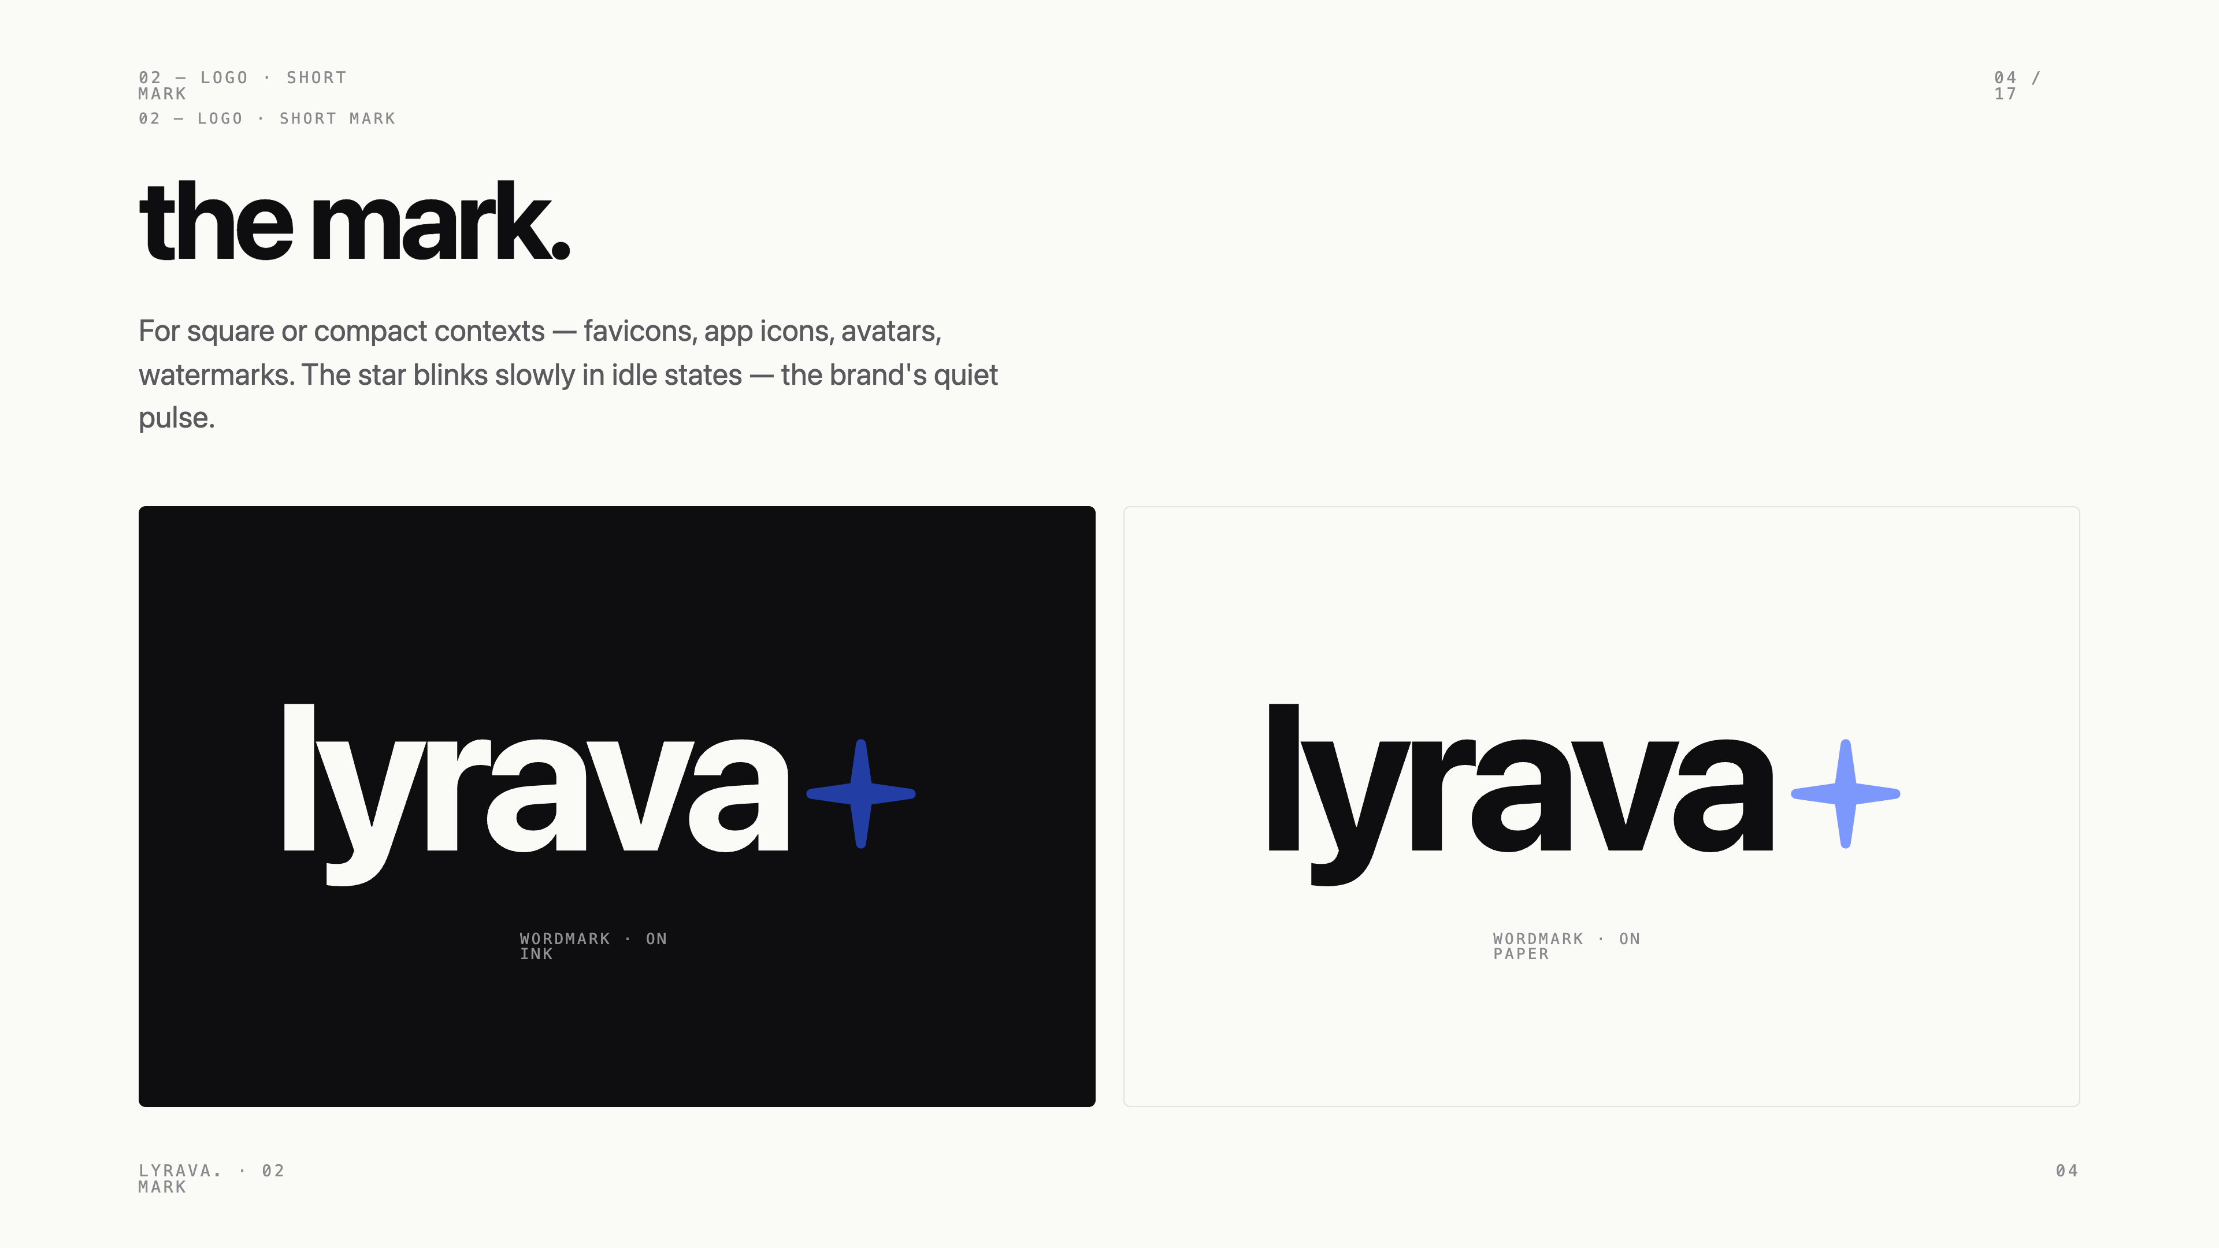
Notes:
Short mark. Two letters and the dot. For favicons, app icons, avatars and small contexts.

Slide 5
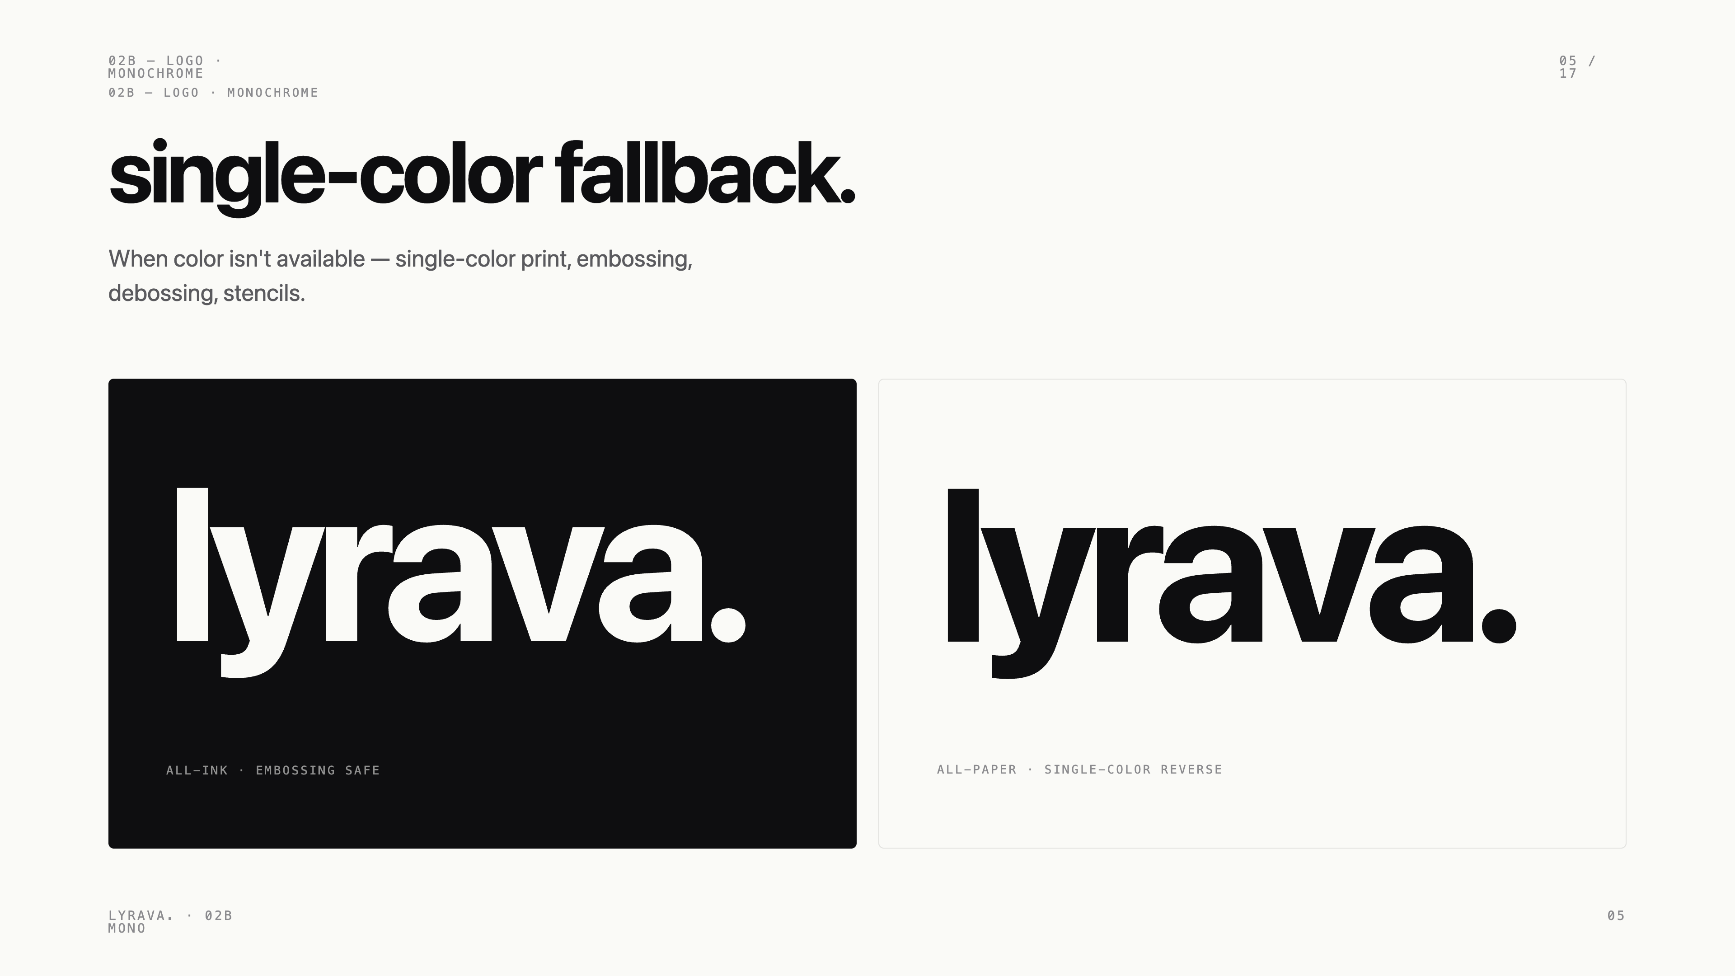
Notes:
Monochrome fallback. For embossing, debossing, single-color print. The dot becomes part of the mark, not a separate color.

Slide 6
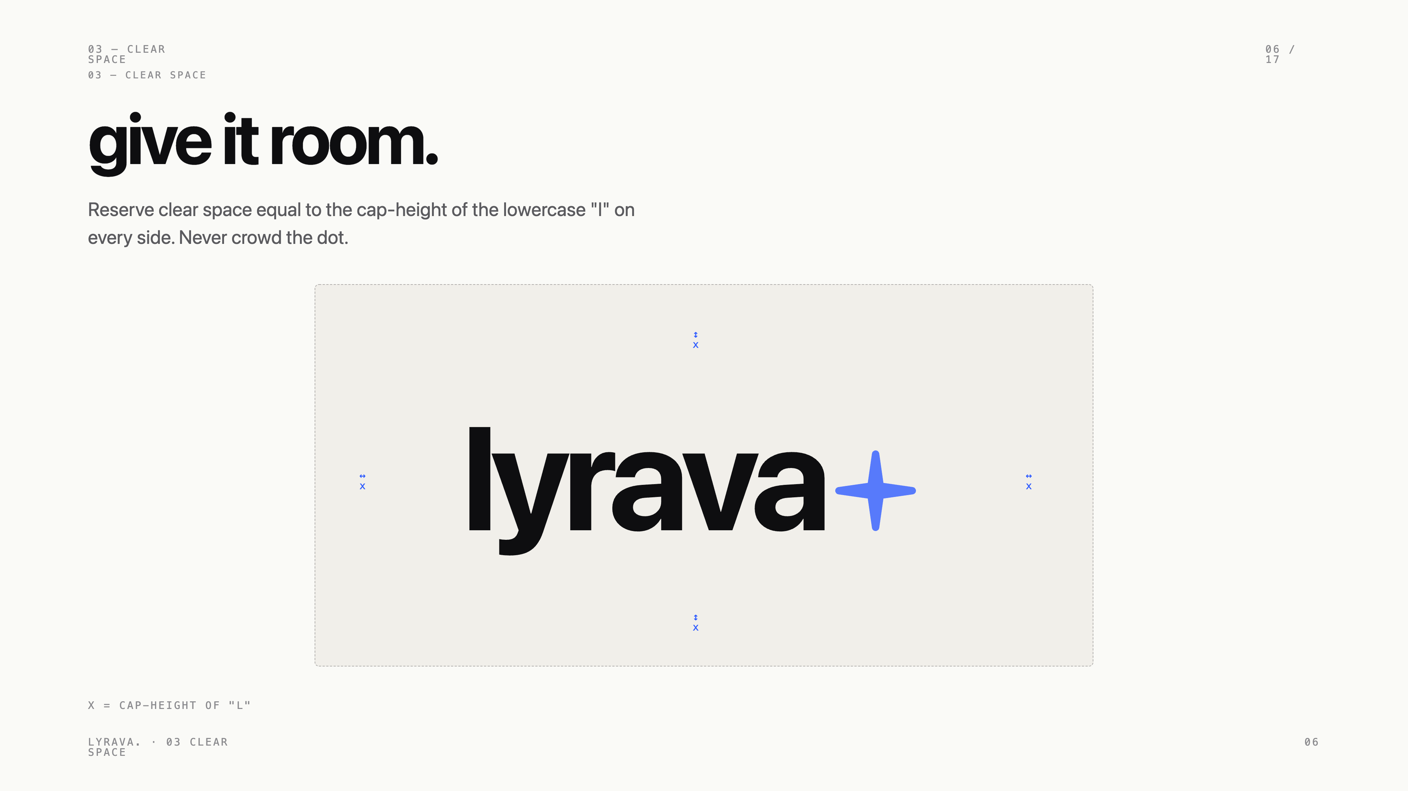
Notes:
Clear space. Reserve cap-height of the lowercase l on every side. Never crowd the dot.

Slide 7
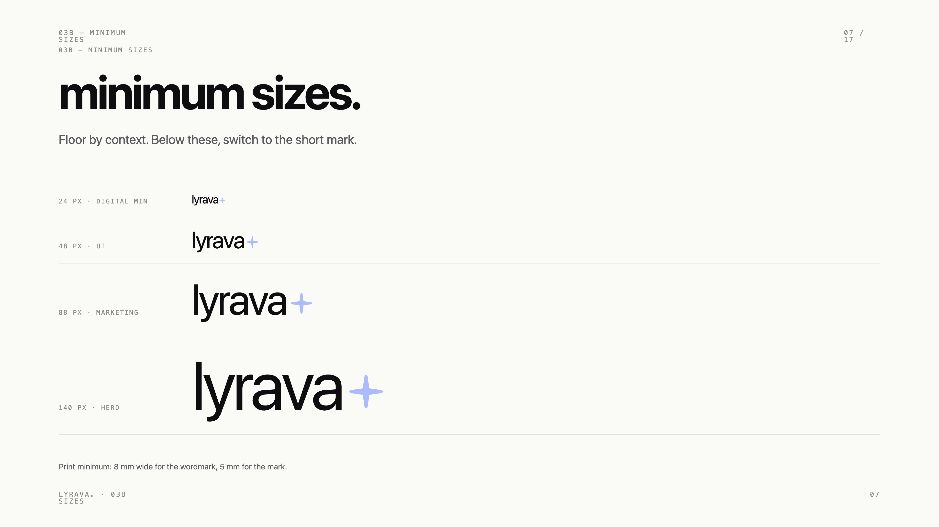
Notes:
Minimum sizes. Below 24 pixels, switch to the short mark. Print floor is 8 millimetres.

Slide 8
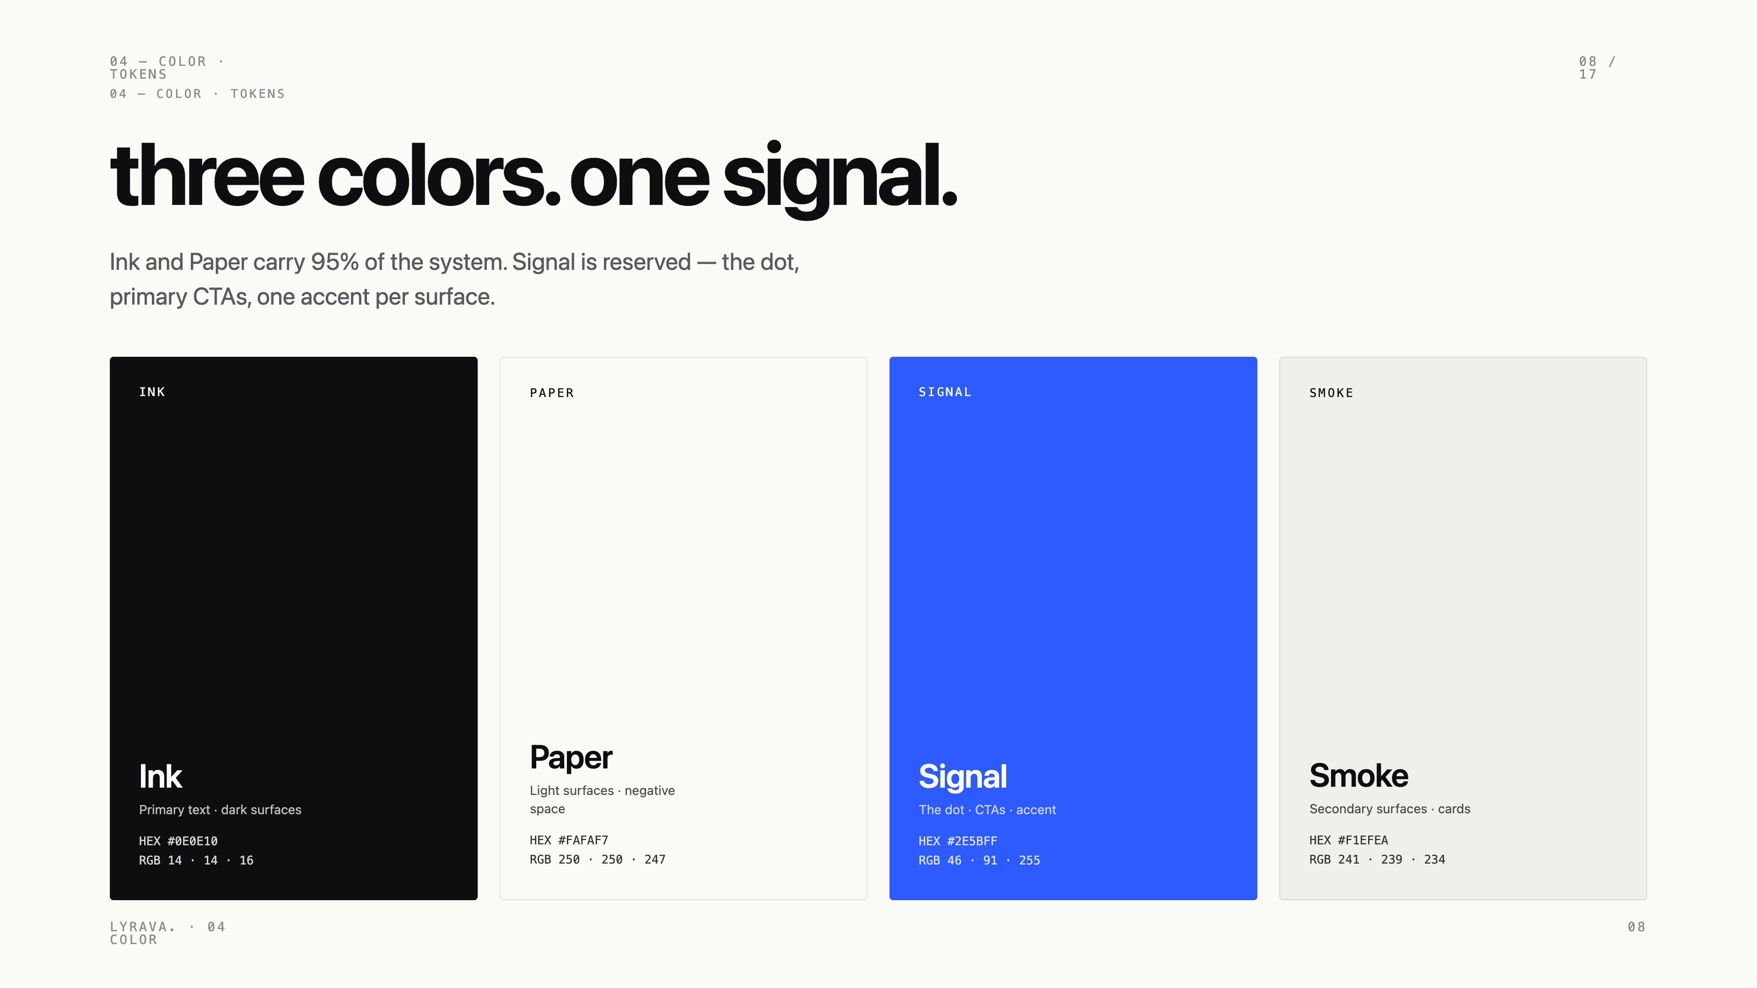
Notes:
Color. Three colors plus a neutral. Ink and Paper carry most of the system. Signal cobalt is reserved.

Slide 9
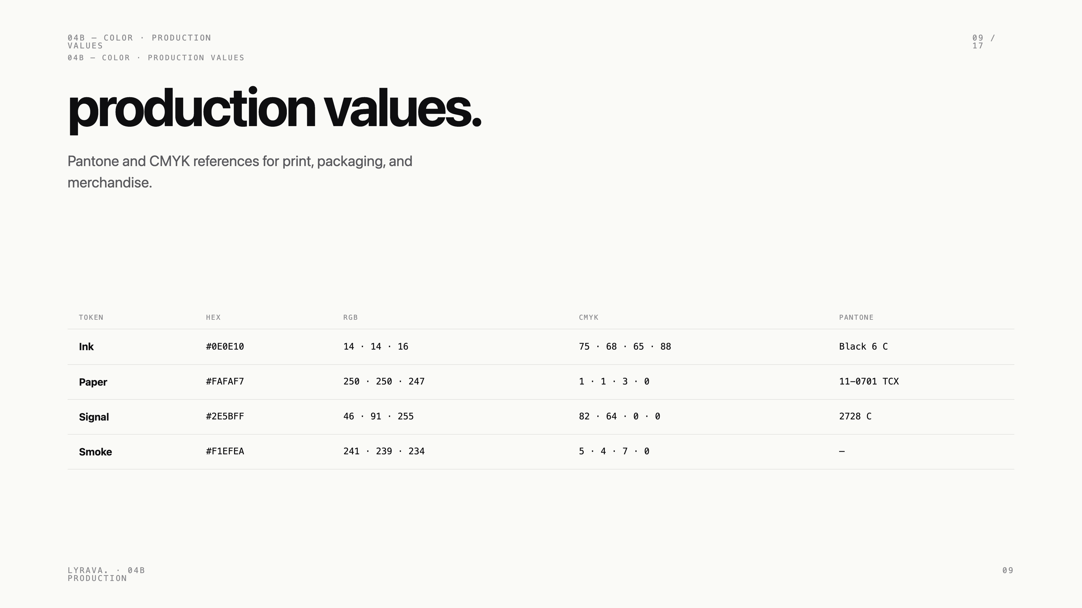
Notes:
Production values. Pantone, CMYK, RGB, hex for every token. Pin to these for print.

Slide 10
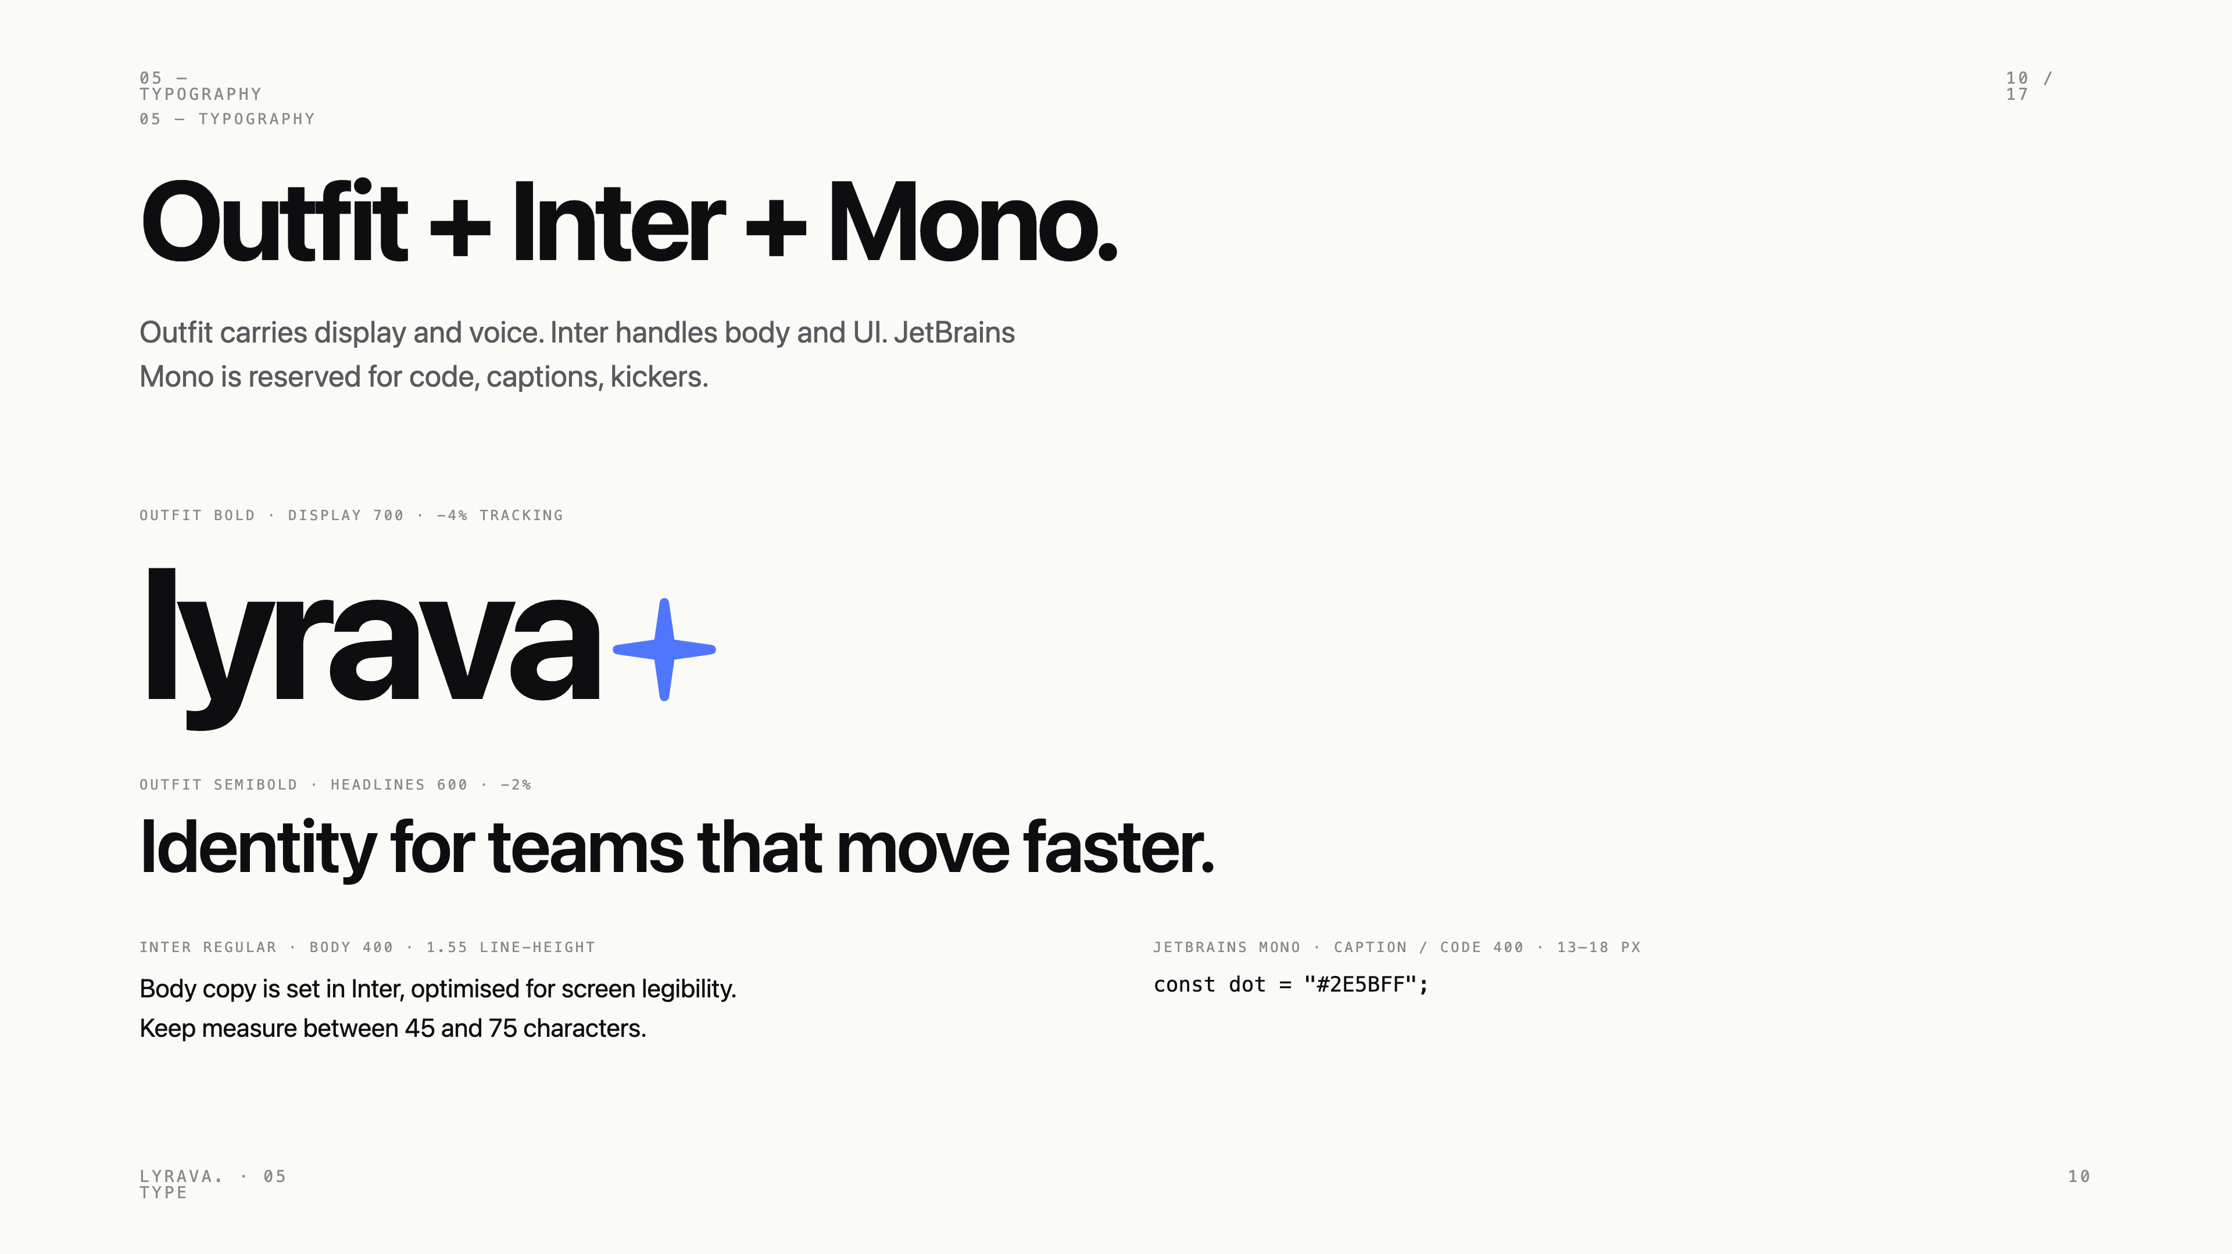
Notes:
Type system. Outfit for display, Inter for body, JetBrains Mono for kickers, captions, code.

Slide 11
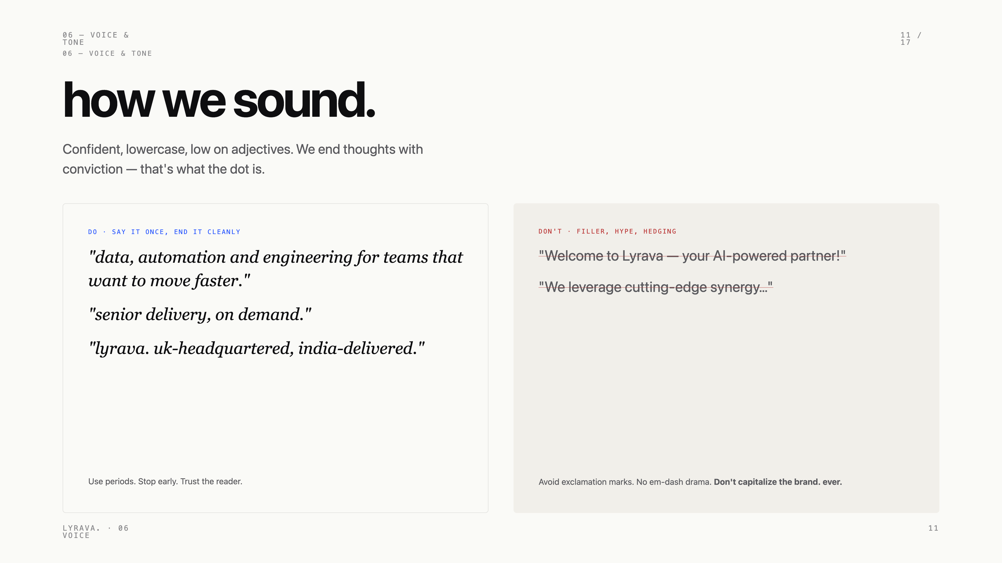
Notes:
Voice. Confident, lowercase, period-stopped. We say it once and we end it cleanly.

Slide 12
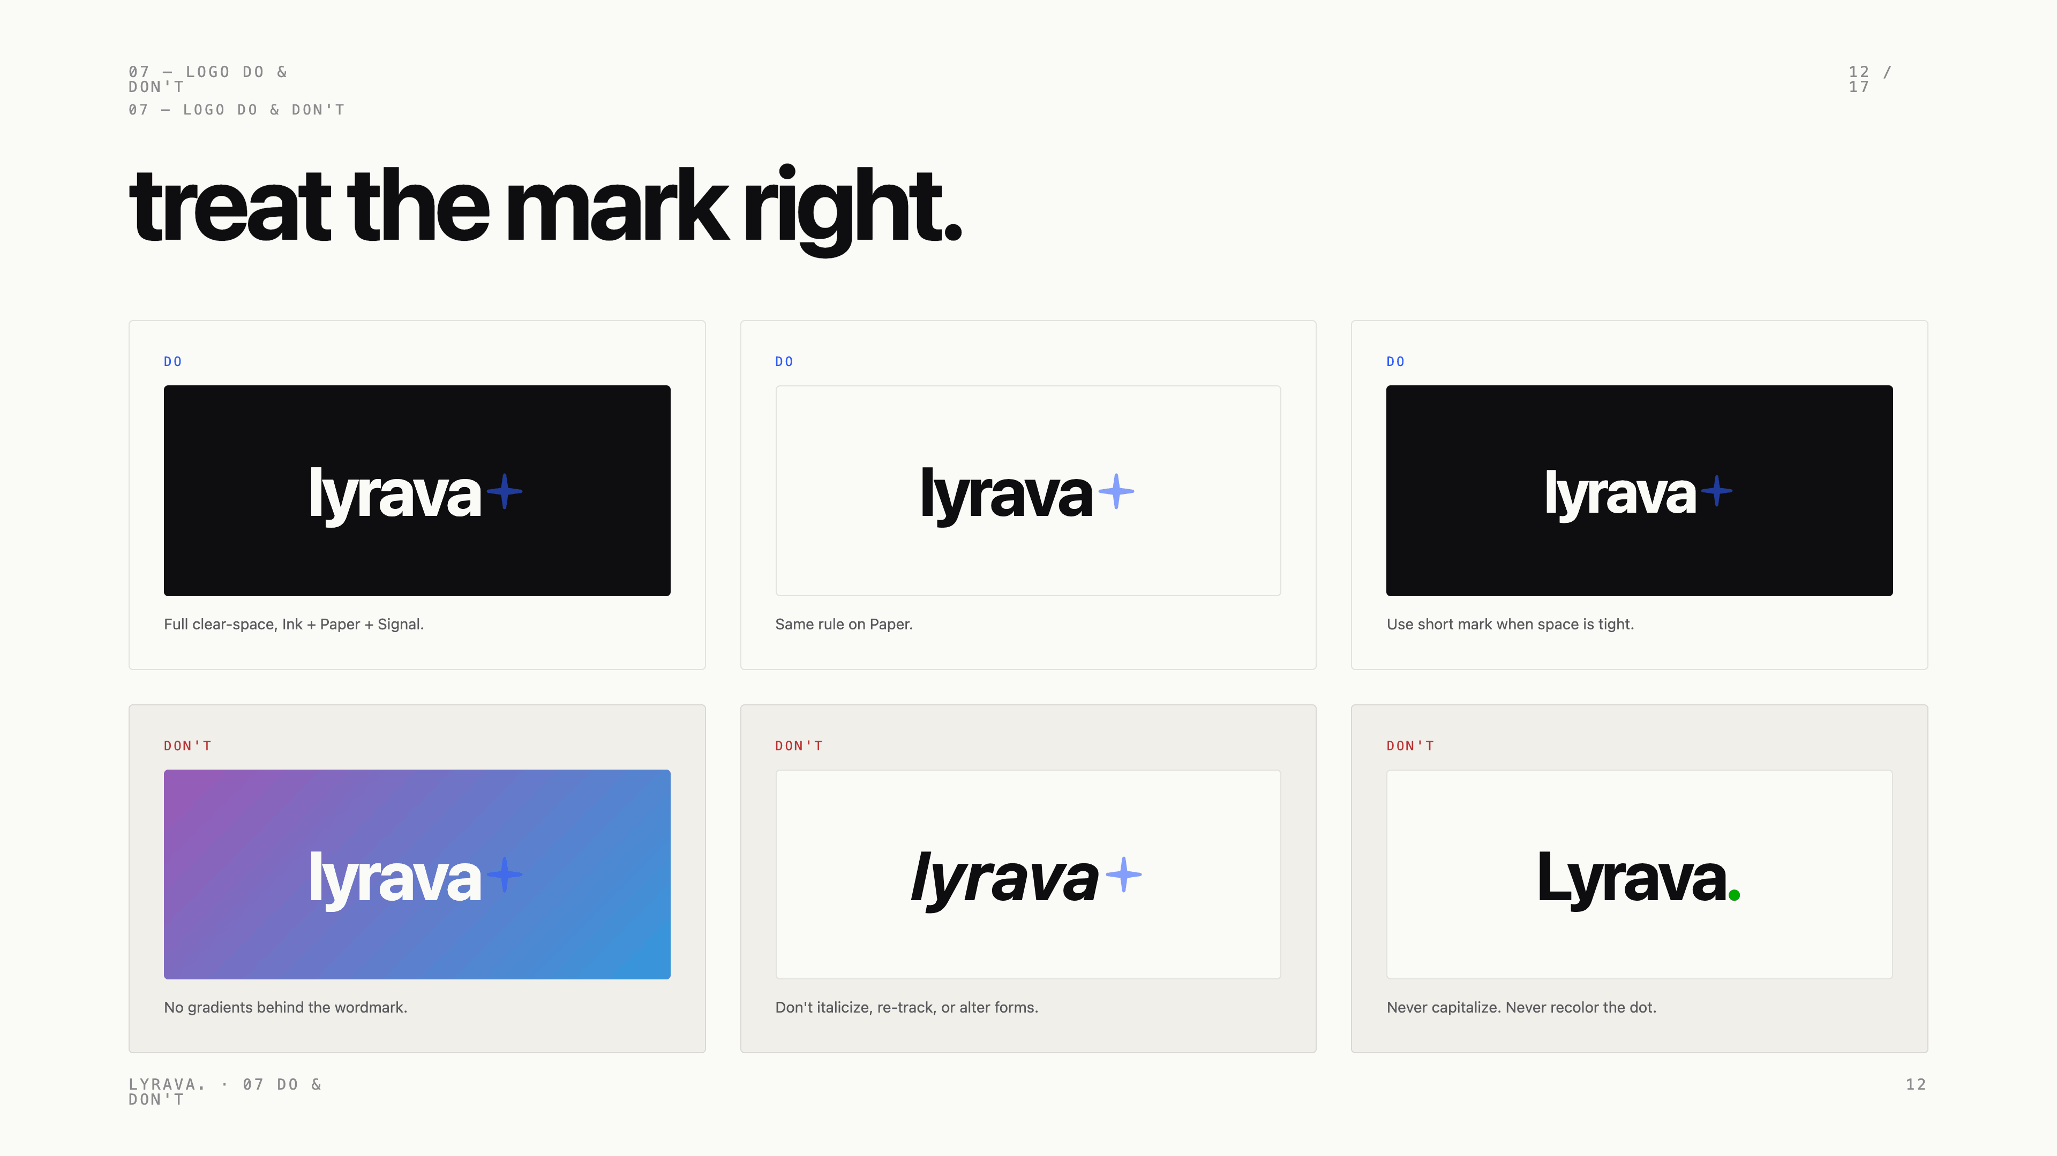
Notes:
Do and don't. Six rules. The dot is non-negotiable, the wordmark is never capitalised.

Slide 13
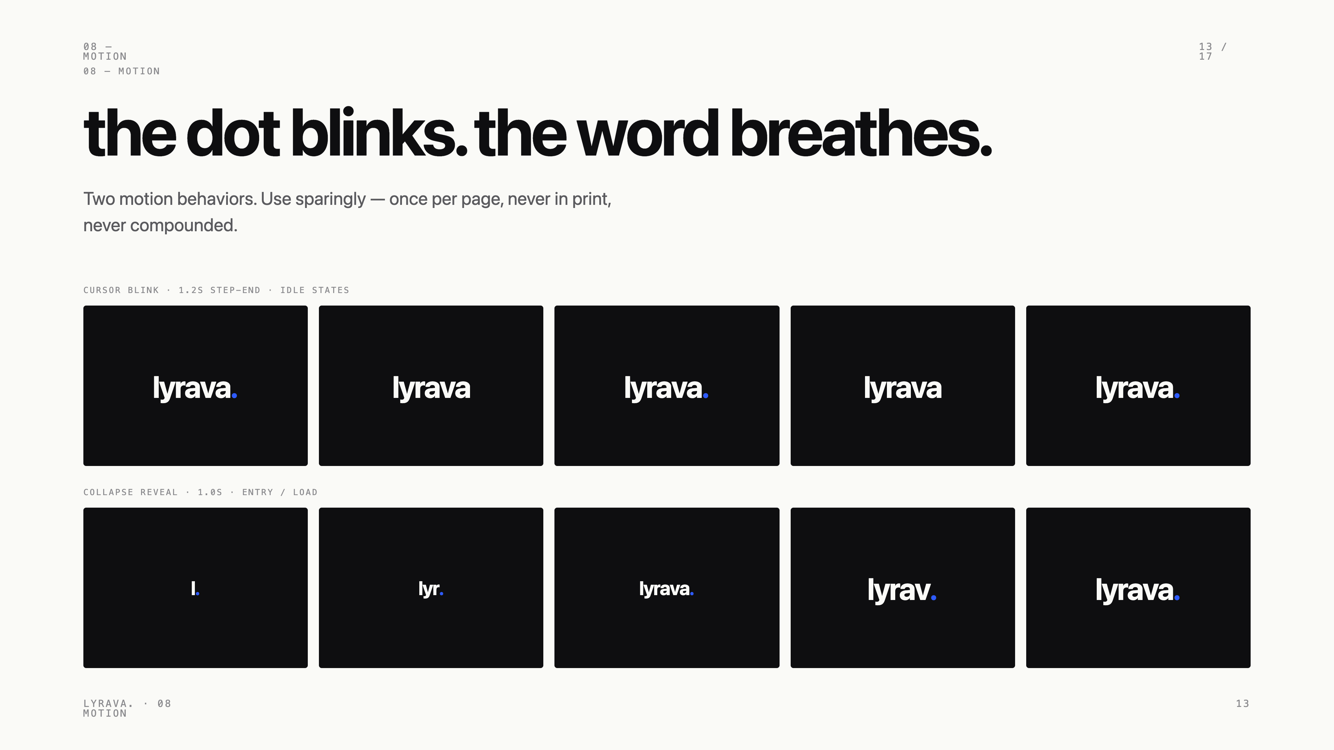
Notes:
Motion. Two behaviors only — the dot blinks, the word collapses on entry. Use sparingly.

Slide 14
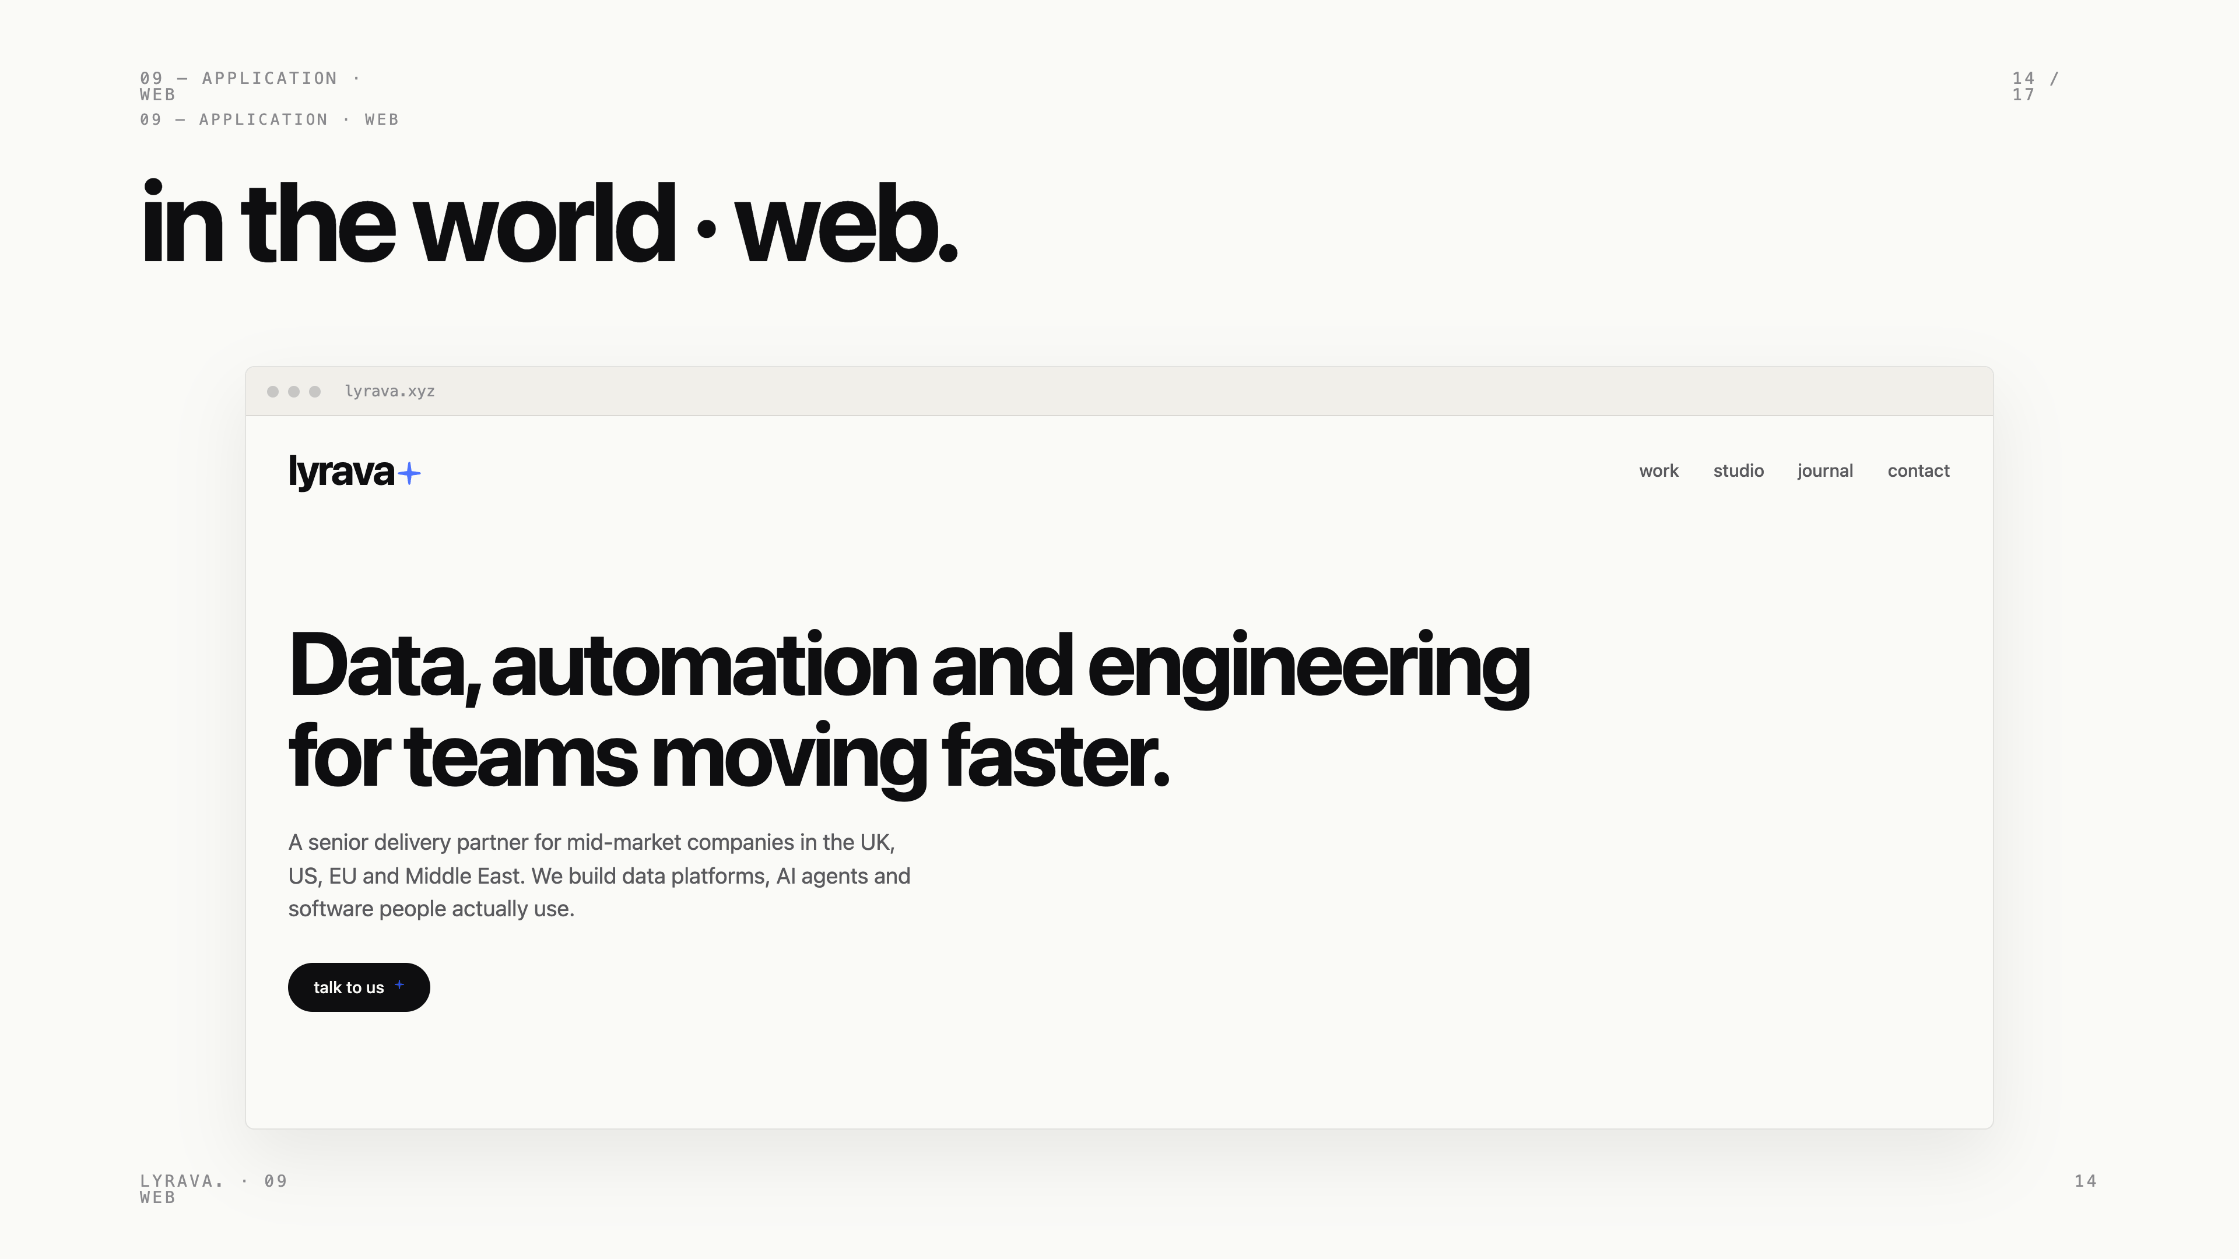
Notes:
Web application. Headers, hero, primary CTA. The dot anchors the mark in the navigation.

Slide 15
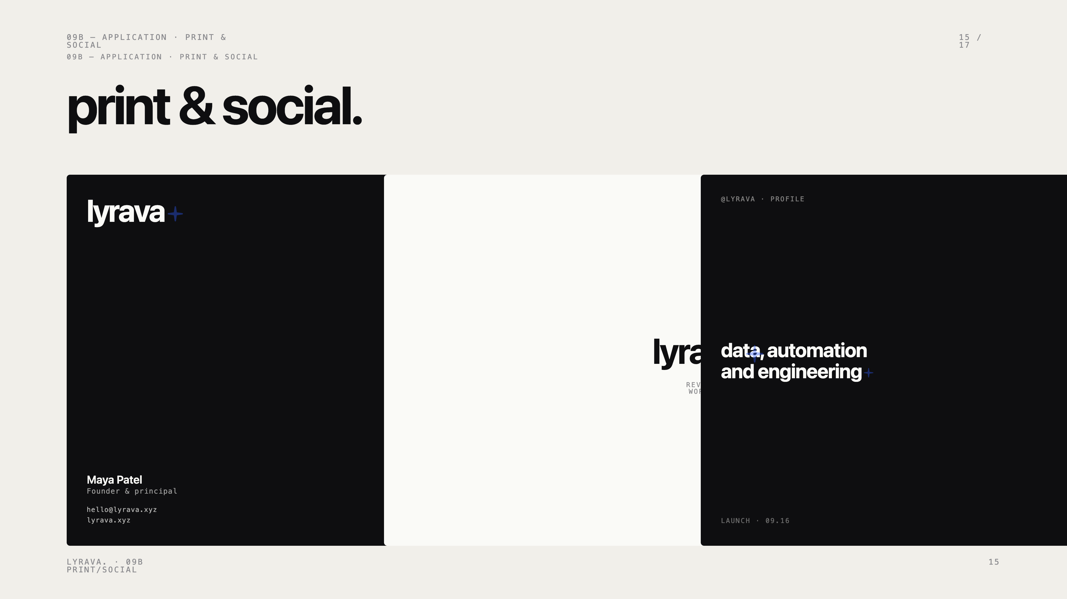
Notes:
Print and social. Business card, social tile, signature block. Same rules, same restraint.

Slide 16
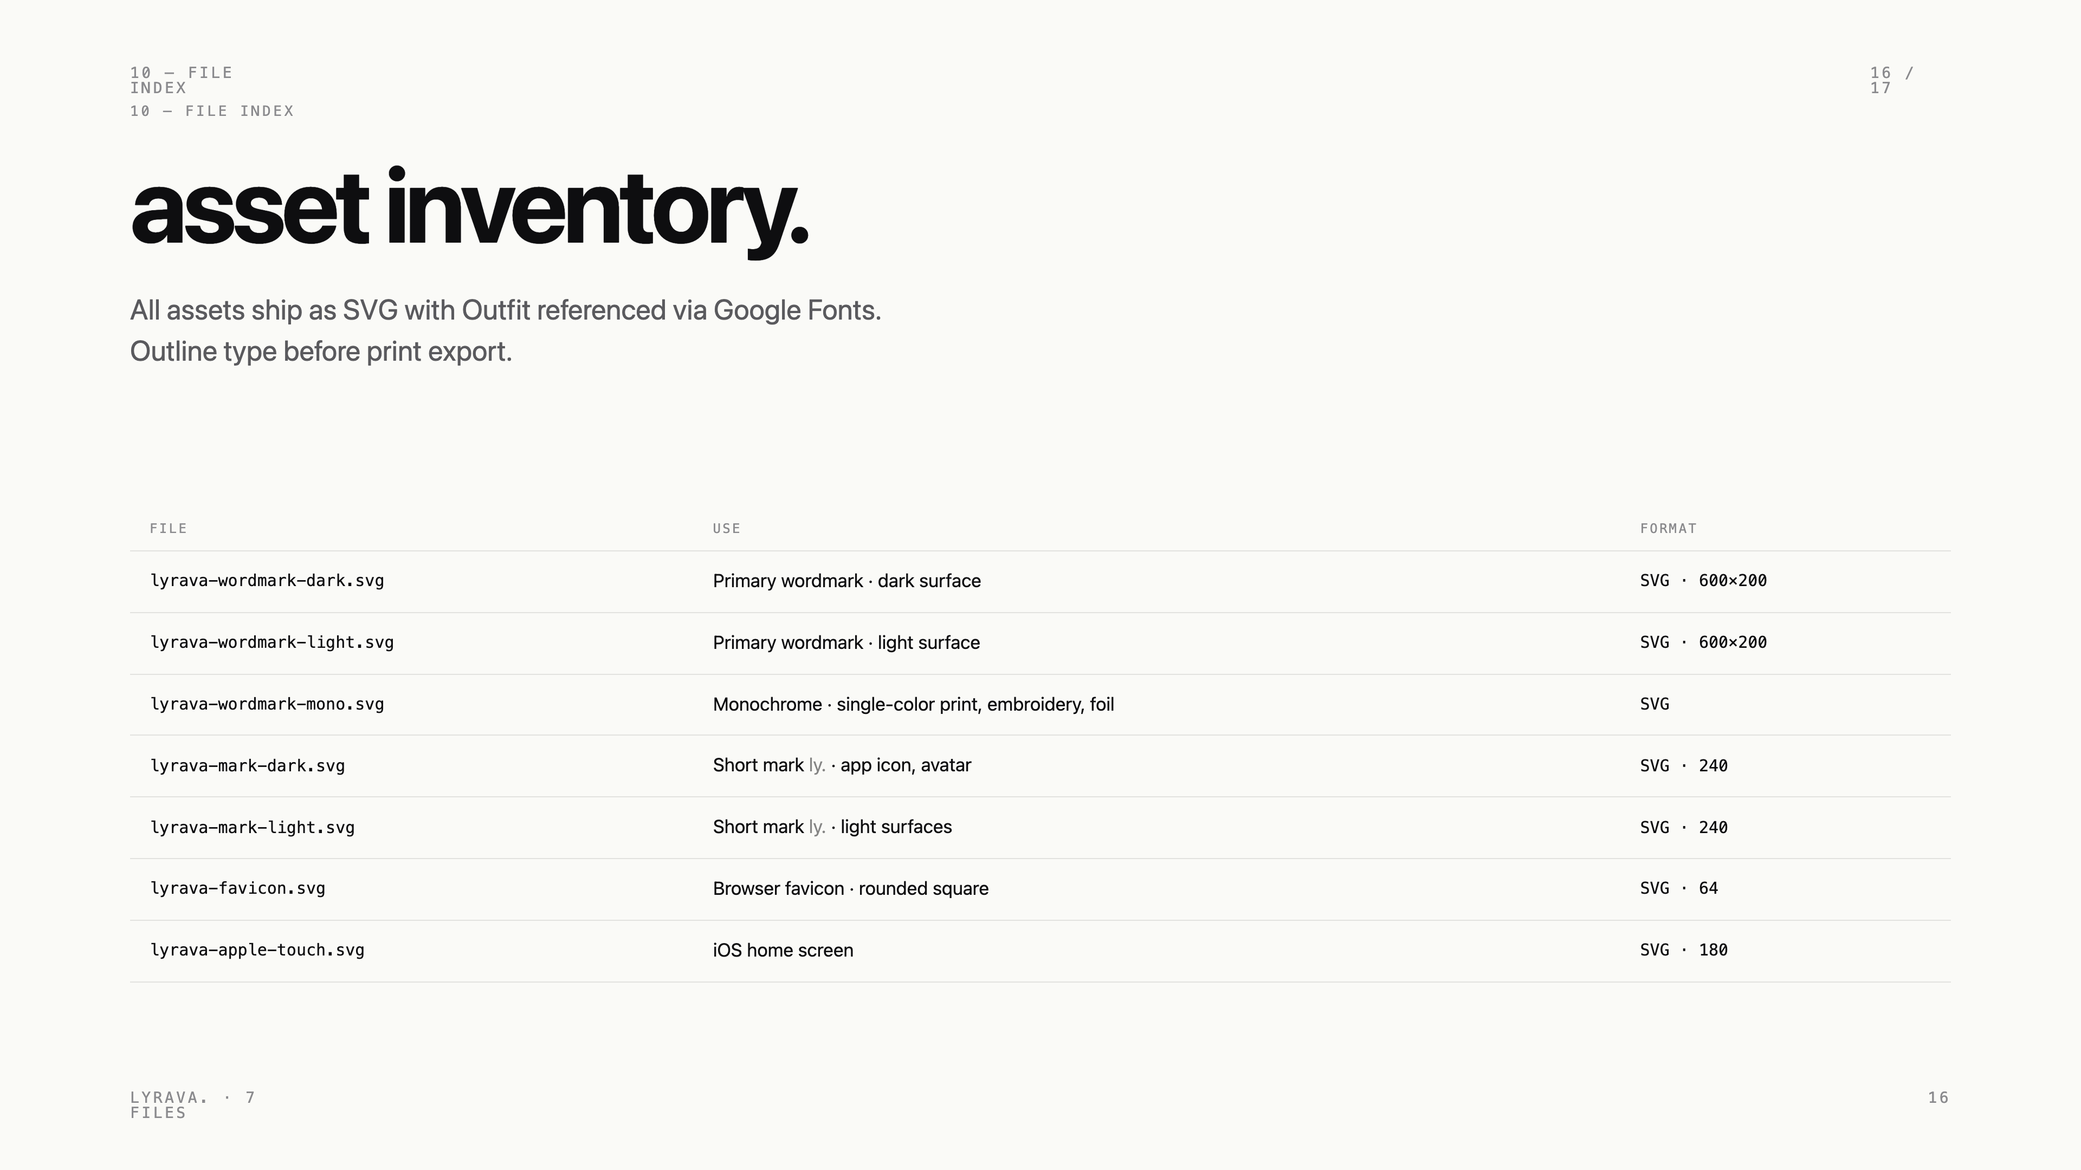
Notes:
File index. SVG-first. Outline type before print export.

Slide 17

Notes:
Thanks. Hello at lyrava dot xyz for brand questions, additions and requests.

